Slide 1
NSF/NASA Dimensions of Biodiversity
The role of taxonomic, functional, genetic, and landscape diversity in food web responses to a changing environment
2013-2018
Anthony R. Ives, UW-Madison
Volker C. Radeloff, UW-Madison
Kerry M. Oliver, University of Georgia
Jason P. Harmon, North Dakota State University

Slide 2
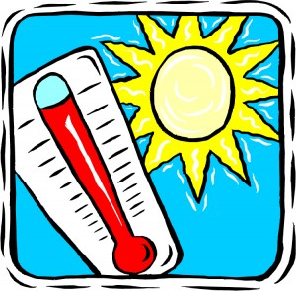
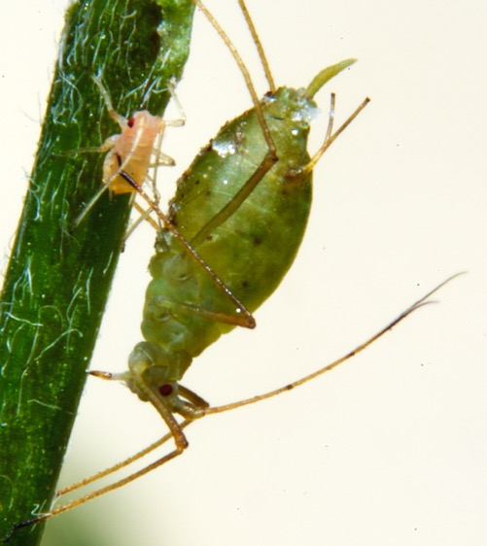
How do species respond to environmental change?

Slide 3



Scale
food webs
individuals
organization

Slide 4
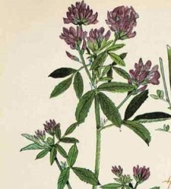
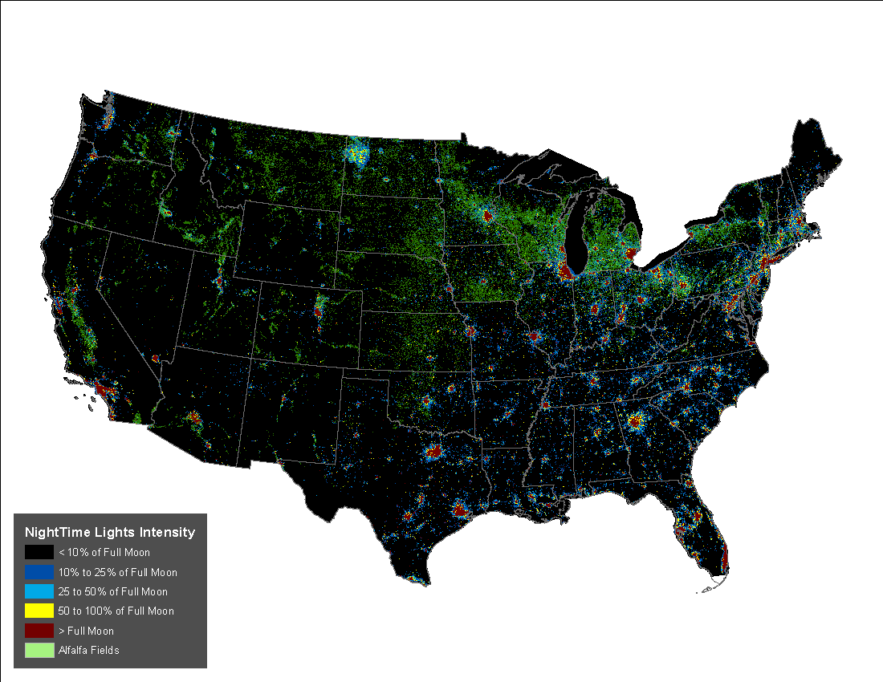
Scale
food webs
individuals
organization
plants
continents
space

Slide 5
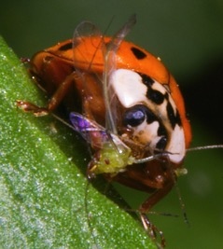
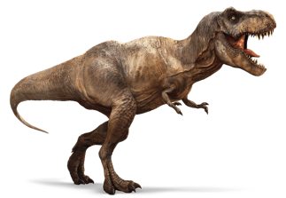
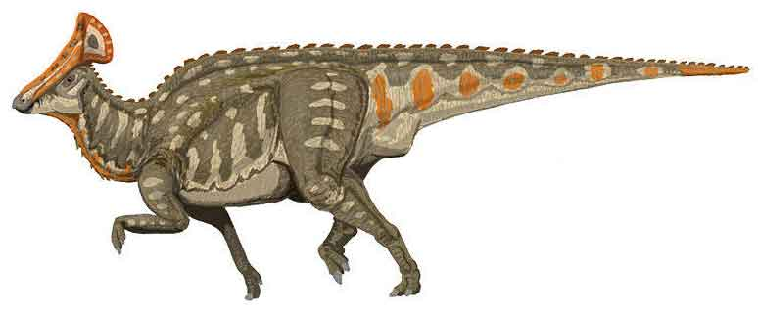
Scale
food webs
individuals
organization
plants
continents
space
event
evolution
time

Slide 6
Project components
1. Co-evolution among insects and bacterial symbionts
2. Environmental effects on aphids and predators
3. Rapid evolution to environmental change
4. Interplay between ecological and evolutionary dynamics
time
organization
space

Slide 7
Project components
1. Co-evolution among insects and bacterial symbionts
2. Environmental effects on aphids and predators
3. Rapid evolution to environmental change
4. Interplay between ecological and evolutionary dynamics
time
organization
space

Slide 8
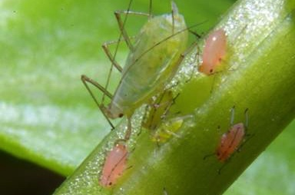

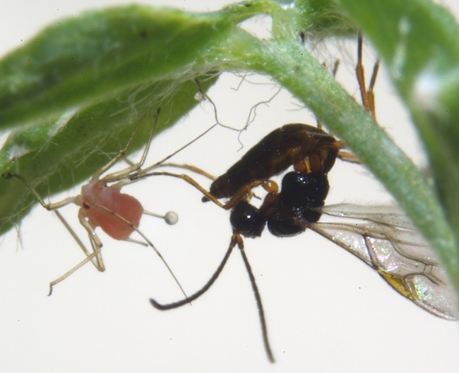
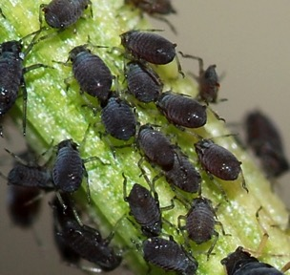
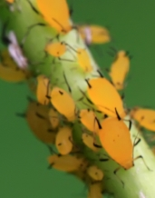
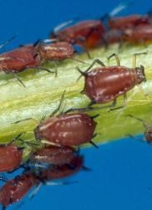
Aphids as a model system

Slide 9
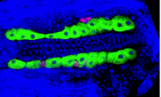
Bacterial symbionts
infect many aphid species
heritable
part of the extended genome of aphids
symbionts within and between aphid cells
Notes:
That appears to be a picture of aphid bacteriocytes (green represents Buchnera cells; blue aphid nuclei) and the pink is showing localization of secondary symbionts like Hamiltonella to sheath cells (upper row) and so-called 'secondary bacteriocytes' (lower row left). Hope this helps!

Slide 10
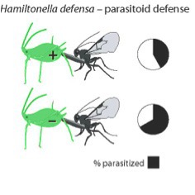
Pea aphid model system for symbiosis
Oliver et al. (2010 Ann. Rev. Entomol.)

Slide 11
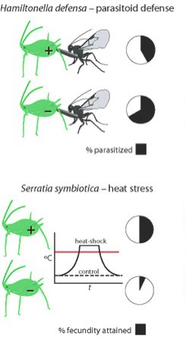
Pea aphid model system for symbiosis
Oliver et al. (2010 Ann. Rev. Entomol.)

Slide 12
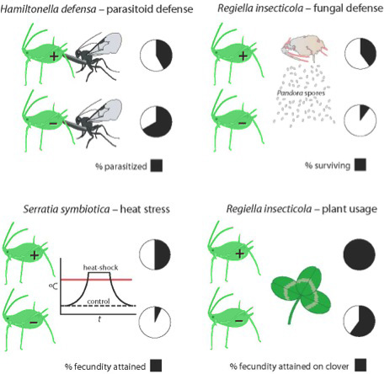
Pea aphid model system for symbiosis
Oliver et al. (2010 Ann. Rev. Entomol.)

Slide 13
Pea aphid model system for symbiosis
Oliver et al. (2010 Ann. Rev. Entomol.)

Slide 14
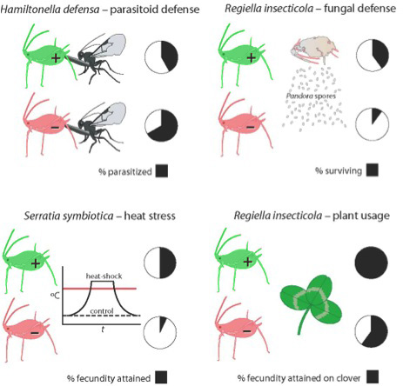
Pea aphid model system for symbiosis
Oliver et al. (2010 Ann. Rev. Entomol.)

Slide 15
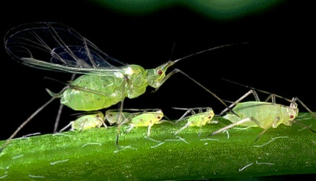
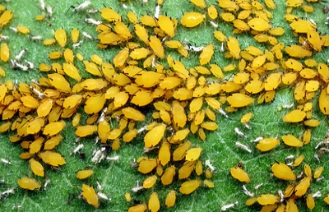
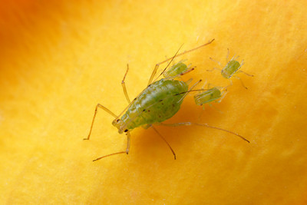
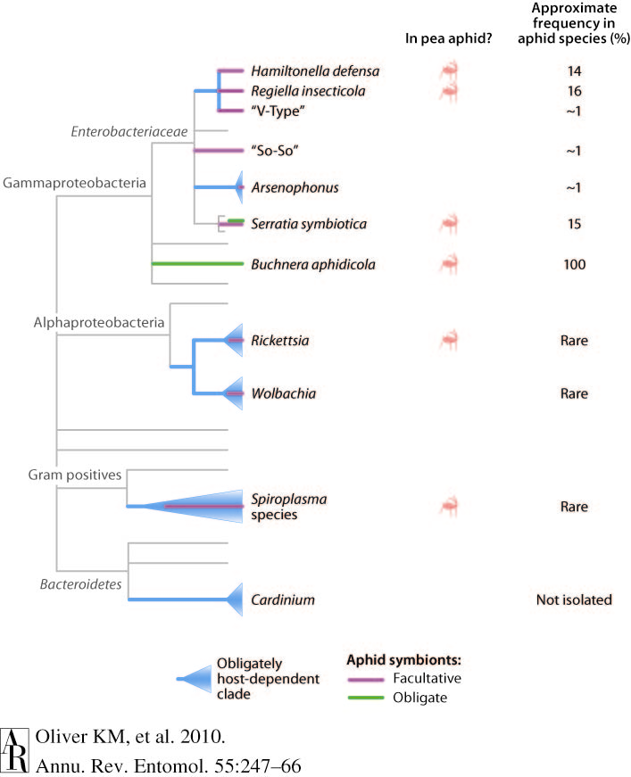
Heritable symbionts in aphids
Photo credit: Alex Wild

Slide 16
Project components
1. Co-evolution among insects and bacterial symbionts
time
Citizen Science Project
volunteers (and their kids) throughout the USA
organization
space

Slide 18
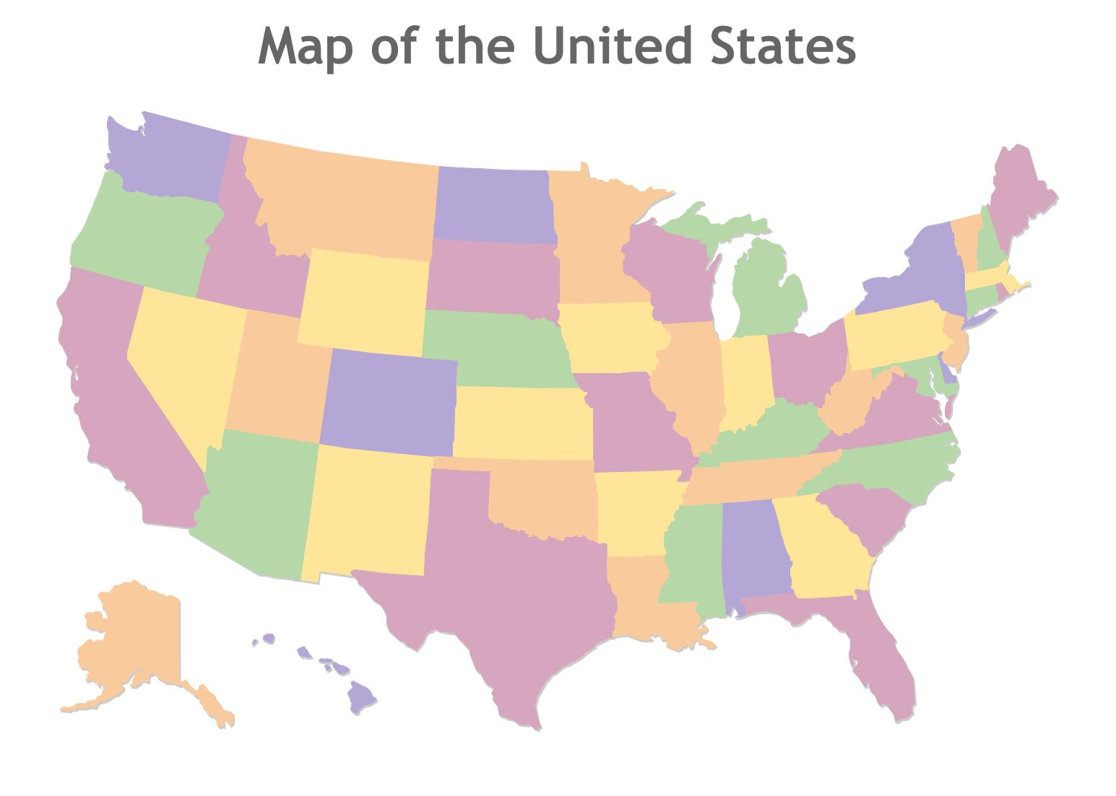
Citizen science collection sites
105 mailers sent
46 mailers received
299 samples
Aphid and plant IDs from genetic fingerprinting
50 aphid species
87 plant species from 36 families

Slide 19
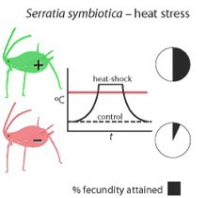
Co-evolution among insects and bacterial symbionts
1. Generate joint evolutionary trees for aphids and symbionts
2. Investigate distribution of symbionts relative to environmental conditions (temperature) using remote sensing

Slide 20
Project components
2. Environmental effects on aphids and predators
time
The joint effects of light pollution and nighttime warming
organization
space

Slide 21
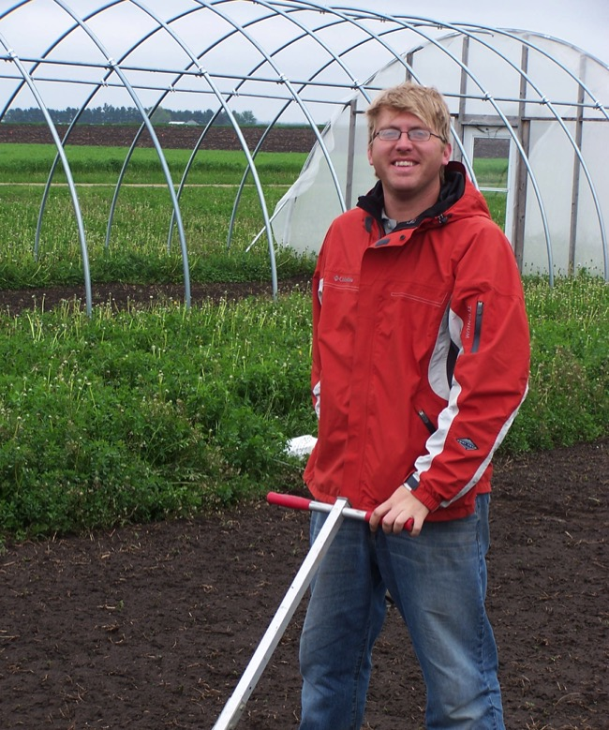
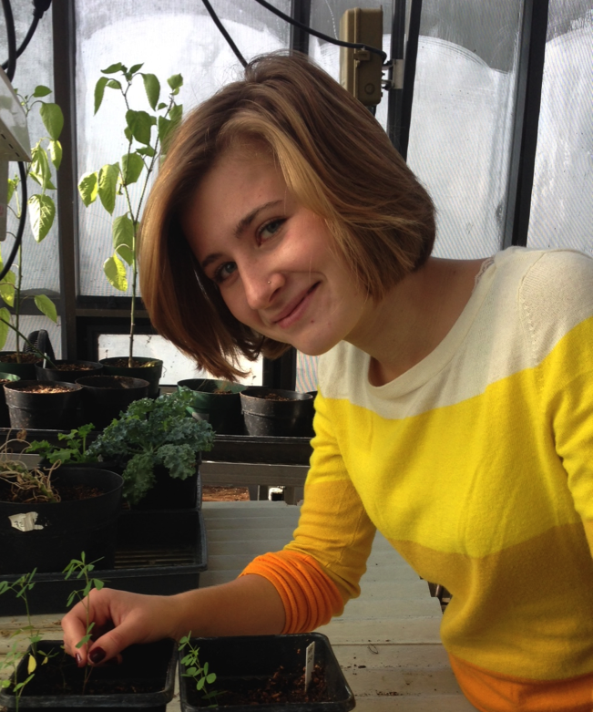
Colleen Miller
Brandon Barton

Slide 22
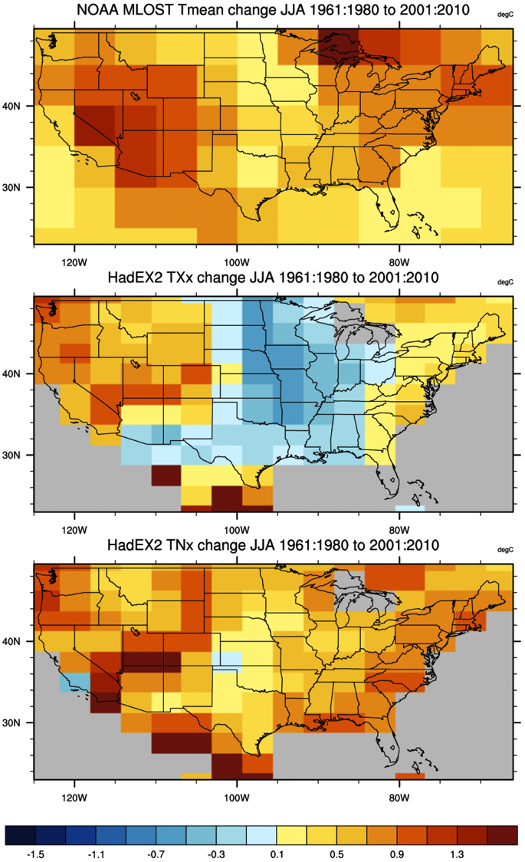
mean
Nighttime warming is greater than daytime warming
1961-2010
daytime
nighttime
Notes:
HadEX2 provides gridded, station-based indices of temperature- and precipitation- related climate extremes. It is intended for climate change detection and attribution studies and climate model evaluation. Twenty-nine indices, including daily maximum and minimum temperatures, number of frost days, maximum 1-day precipitation, and growing season length are provided for 1901 to 2010 at monthly timesteps on a 2.5° latitude x 3.75 ° longitude grid. Definitions of these core indices follow recommendations set forth by the CCl/CLIVAR/JCOMM Expert Team on Climate Change Detection and Indices (ETTCCDI). Input data are from approximately 7000 temperature and 11000 precipitation observing stations distributed worldwide. The indices are computed for each station, and then the indices are gridded using an angular distance weighting scheme. Compared with the precipitation-based indices, the temperature-based indices generally show larger spatial coherence and large-scale averages that are more robust to sampling gaps.

Slide 23
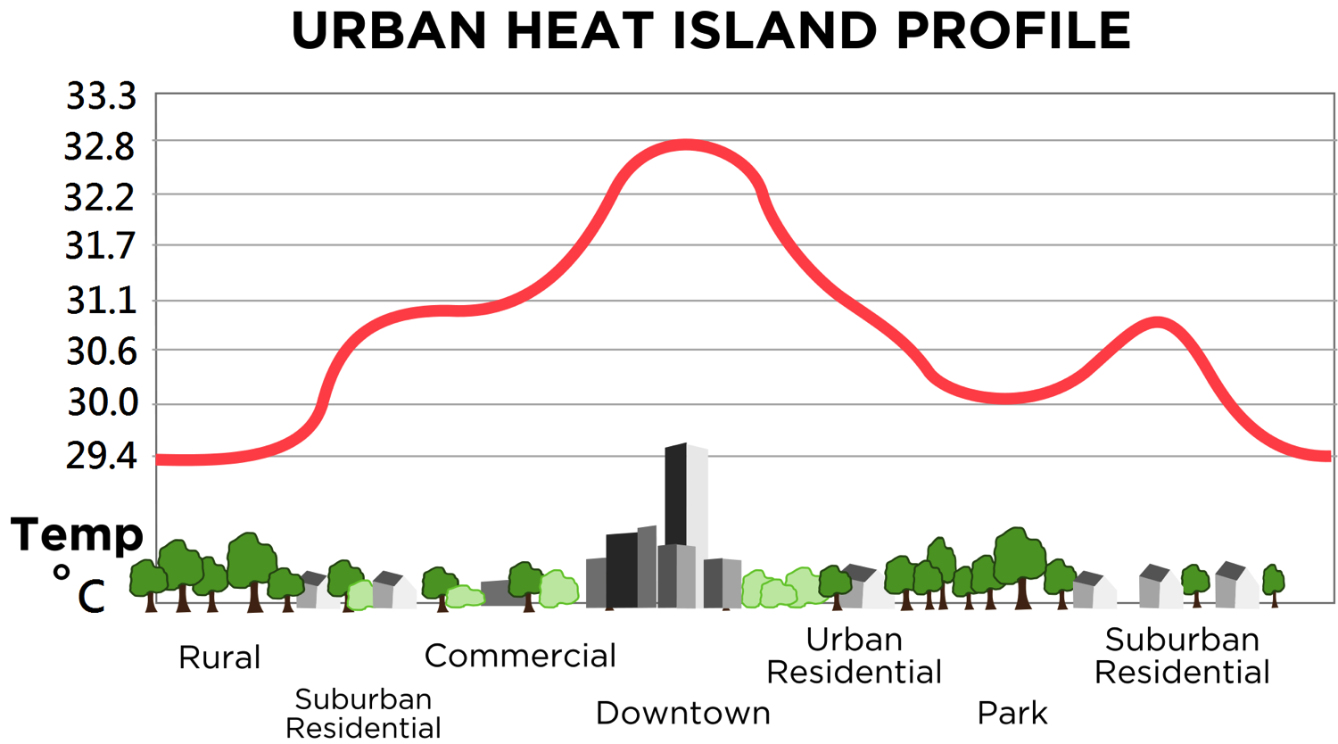
Local warming: urban heat island

Slide 24
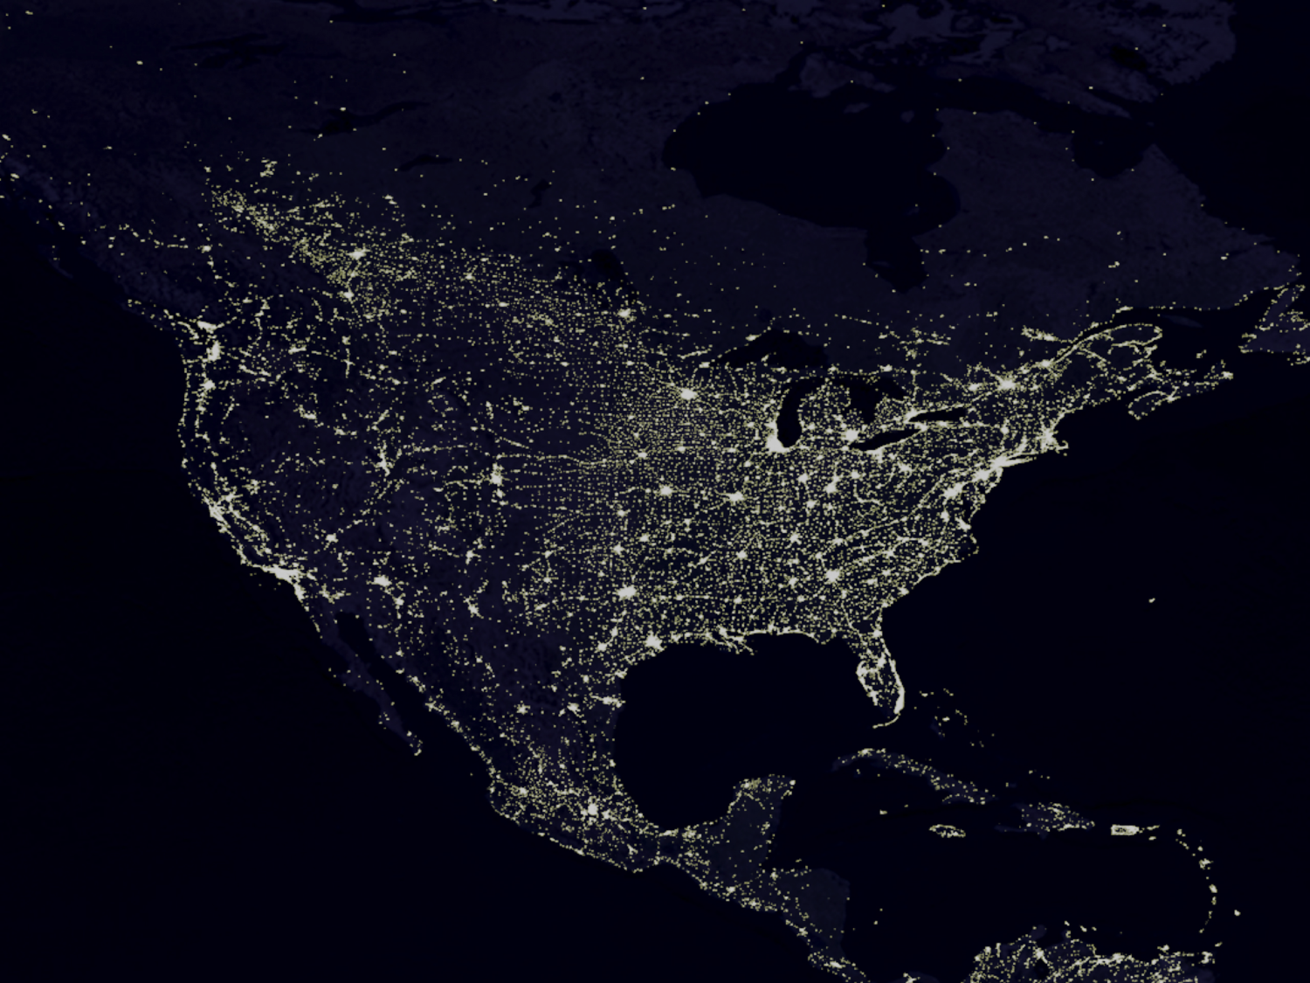
Light pollution

Slide 25
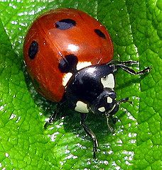

Night warming only
Night warming

Slide 26
Light pollution only
Light
pollution
Light
pollution

Slide 27
Night warming
and light pollution
Night warming
Light
pollution
Light
pollution
Can the effects of both be predicted from their separate effects?

Slide 28
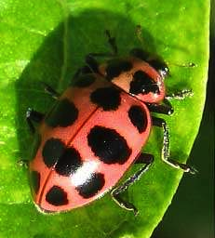
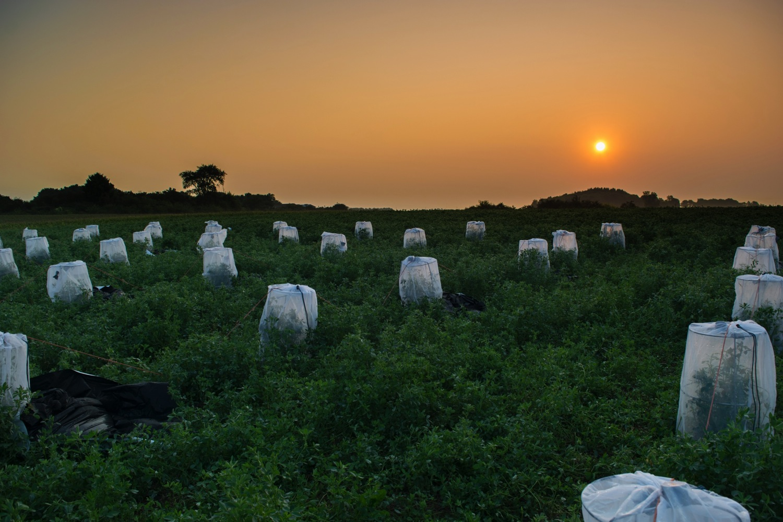
C7
Visual hunter
Cmac
Hunts in the dark

Slide 29


LEDs
Black bags of water
+2° C above ambient
2 x 2 x 3 design
Light x Warming x Predators
96 cages for 9 days

Slide 30
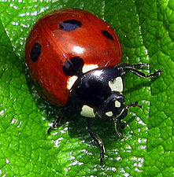

Visual predator
Light
pollution
Number of aphids
Notes:
Conceptualized species interactions, food web. With indirect effects.

Slide 31
Visual predator
Night warming
Light
pollution
Number of aphids
Notes:
Conceptualized species interactions, food web. With indirect effects.

Slide 32
Visual predator
Light
pollution
Light
pollution
Number of aphids
Notes:
Conceptualized species interactions, food web. With indirect effects.

Slide 33
Visual predator
Night warming
Light
pollution
Light
pollution
PREDICTED
Number of aphids
Notes:
Conceptualized species interactions, food web. With indirect effects.

Slide 34
Visual predator
Night warming
Light
pollution
Light
pollution
PREDICTED
Number of aphids
OBSERVED
Notes:
Conceptualized species interactions, food web. With indirect effects.

Slide 35
C7
Visual hunter
Number of aphids
Cmac
Hunts in the dark
Number of aphids
Notes:
Conceptualized species interactions, food web. With indirect effects.

Slide 36
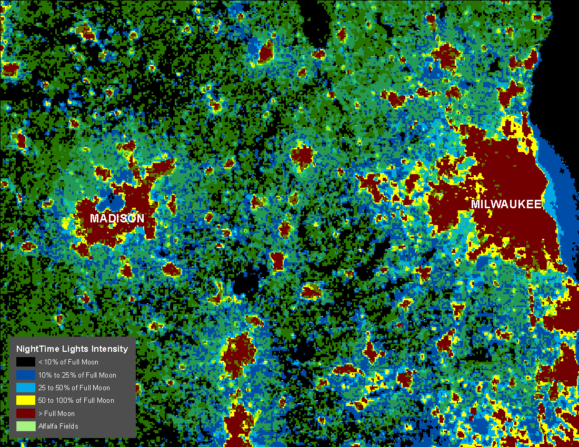
field

Slide 37
Full moon | Total | Alfalfa
≥full moon | 2.4% | 1.1%
50 - 100% | 1.3 | 1.3
25 - 50% | 2.0 | 2.8
10 - 25% | 5.8 | 12.3
<10% | 88.5 | 82.4
scaled to full moon reflectance from clouds
largest impact for urban gardens
Notes:
Constrast to yesterday - theory vs. empirical
Strange talk - not going to talk about stuff that I’ve done - lab talk
Collected 12 talks given by people in the lab - condensed down to a single talk
You might be thinking that you are about to experience a 3 hour train wreck - I really did shortened things, so the train wreck should last less than 1 hour

Slide 38
Night warming
Light
pollution
Light
pollution
Can we predict the joint effects of two changes from their separate effects?
It depends on the ladybeetle.
How much can we learn from small-scale experiments?
Remote sensing puts field experiments into context
Notes:
Conceptualized species interactions, food web. With indirect effects.

Slide 39
Project components
1. Co-evolution among insects and bacterial symbionts
2. Environmental effects on aphids and predators
3. Rapid evolution to environmental change
4. Interplay between ecological and evolutionary dynamics
time
organization
space

Slide 40
Scale
food webs
individuals
organization
plants
continents
space
event
evolution
time

Slide 41
Project components
1. Co-evolution among insects and bacterial symbionts
2. Environmental effects on aphids and predators
3. Rapid evolution to environmental change
4. Interplay between ecological and evolutionary dynamics
time
organization
space

